Slide 1
2025 Toronto Sport Summit Presentation

Slide 2
CSCO Sustainability report
Research objective:
To make strategic operational recommendations on the sustainability for Ontario’s based community-based sport organizations to ensure a sustainable future
Research methodology:
A literature review of 500 World best operational best practices
27 best practice themes were identified which were summarized down to 15 themes
An alignment of themes with survey questions completed to assess sport organization operational effectiveness
An online survey was used to obtain responses from sport organizations
Gaps were identified between current and ideal practices
providing an opportunity to make strategic recommendations
to enhance the operational effectiveness of Ontario’s
community sport organizations
Notes:
Research objective
Post COVID, CSCO wanted to assess the health of Ontario’s community sport network
We wanted to assess operational best practices in Canada and the world and then compare with Ontario practices
Research methodology
Literature review of 500 abstracts
Identified 27 best practice themes which were condensed to 15 major themes
Online survey adopted with 15 themes aligned to survey questions for convenience
A gap analysis was used to identify perceived gaps for recommendations to be made for Ontarios sport community

Slide 3
CSCO Sustainability report
Survey sample
Survey had 123 multi-sport responses from the community sport sector of Community Sport Councils and Accessible Sport Councils and their members and affiliates representing thousands of community-based sport organizations from 41 communities in Ontario.
Overall, 14 recommendations were identified in five key areas;
Strengthen Partnerships & Collaboration: Community Hub & Sport Durham
Recommendations: Partner with schools, health authorities, tourism boards, and
both traditional and non-traditional community groups
Enhance Community Engagement & Inclusion
Recommendations: Host local events, multilingual programs,
‘try-It’ days and adaptive friendly programs
Variety village & Abilities Centre
Notes:
Survey sample
123 responses from many community multi-sport non profits representing thousands of community sport organizations in Ontario
Over recommendations
Strengthen Partnerships & Collaboration
Local examples;
Community hubs across Ontario involving a collaboration of groups (Municipality, Education, Sport)
Sport Durham-supported by local economic development (focused on Sport Tourism)
2. Enhanced Community Engagement & Inclusion
Increase visibility of sport org and programs
Host more local events-cultivate relationship with media
Hold multilingual programs (offer diverse program offerings to react to changing community demographics)
Hold try it days more often to encourage new Canadians, new participants of all ages
Variety village and the Abilities Centre in Whitby are good examples of this…
2. Enhance Community Engagement & Inclusion

Slide 4



CSCO Sustainability report
3. Improve Funding & Sustainability of community sport organization
Recommendations:
Grow local, corporate and Government support, grants, and consider
impact reporting (economic & health impacts) while exploring digital
and hybrid program models
4. Advocate for improved Facilities & Space Access
Recommendations:
Joint municipal advocacy for accessible, affordable and adequate
sport facilities and consider community-use agreements
5. Build Leadership, Volunteers & Organizational capacity
Recommendations:
Strengthen Youth leadership pathways, enhance volunteer training,
complete annual reviews and develop resource hubs
Local Municipal Community Centres
Notes:
3. Improve funding & sustainability of sport orgs
Research identified more funding is needed for support of grassroots sport programs, sport group reach out to corporate was underutilized
Examples: Reach out to Corporate more often-most groups underutilize opportunities
Hydro One (Coaches program support)_
Kidsport Ontario (Youth program support)
Both companies fund programs which support opportunities for participation and coaching
Impact reporting-economic and health impacts (Evidence based no’ mean everything these days)-proves demand and overall need
Explore innovative programming-online and hybrid program models (multiple training methods)
Explore digital and hybrid program models;
-Digital-online program
-Hybrid-multiple training methods
4. Advocate for improved facilities and increase access to sport play space
General statement: Many facilities in Ontario were built in the 60’s and 70’s many need to be retrofitted or replaced…
Examples:
Local municipal community centers-connect with them they would be please to work with local sport groups
Connect with Municipality, lobby them showing the need from the community
Establish join use agreements with the municipality, private operators, schools (share resources, planning, maintenance etc)
5. Build leadership, volunteers and organizational capacity
Develop Youth leadership opportunities i.e. Toronto Sport Leadership program is a good example of a local municipal initiative!
Complete annual reviews of all types (program, organization)
Develop resource hubs to share information for your network of members

Slide 5

CSCO Sustainability report
From Research to Action for Community Sport Organization sustainability
Next steps?
Review the research findings (75 page report) which is available online at https://communitysportcouncils.com which includes all 27 themes, 14 recommendations condensed into 5 key areas for presentation today
Evaluate recommendations based on your local conditions and set priorities for future actions
Identify resources needed and track progress to ensure
positive sport organization outcomes.
Connect with Community Sport Councils Ontario for support,
resources and advice and then become involved in the Sport in
Ontario Collective
Have a question or need more information?
Contact Kevin Arnsdorf E mail: kevinacsco@gmail.com
Kevin Arnsdorf, MBA/BPE
Lead Researcher (l)

Slide 6
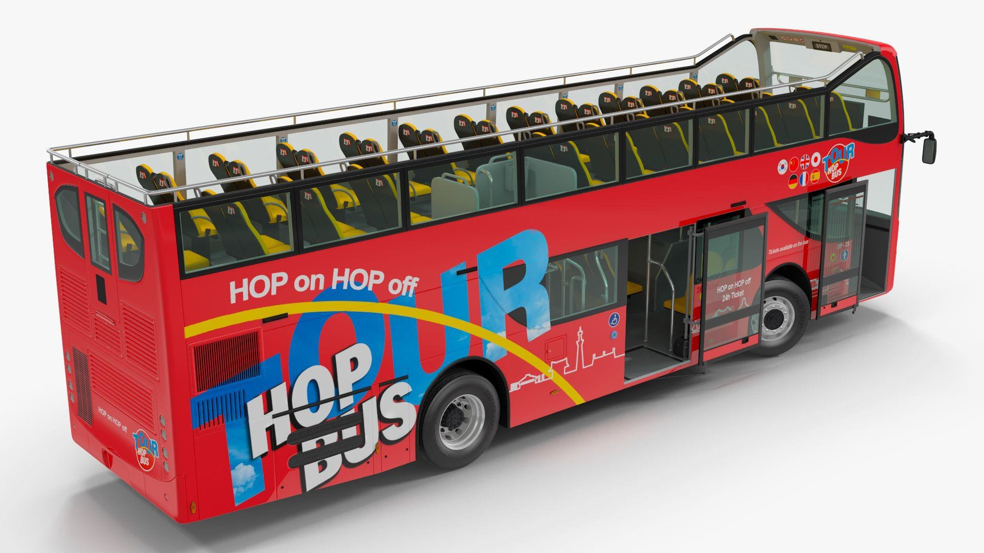

From Research to Action. The Sport in Ontario Collective. It’s all about the conversations and collaboration
Anyone who cares about the future of sport in Ontario is welcome to be part of the collective … and they can Hop On and Hop Off the journey anytime…

Slide 7

The Collaboration Continuum
Compete | Co-exist | Communicate | Cooperate | Coordinate | Collaborate | Integrate
Competition | No | Inter-agency | As needed, | Organizations | Longer term | Fully
for clients, | Systematic | information | often | systematically | interaction | integrated
resources, | Connection | sharing (e.g. | informal, | adjust and | based on | programs,
partners, public attention. | between agencies. | networking). | interaction, on discrete activities or projects. | align work with each other for greater outcomes. | shared mission, goals; shared decision- makers and resources. | planning, funding.
Trust

Slide 8


Taking a Collective Impact Approach by Advancing Collaboration
A Common Agenda
a shared vision for change, one that includes a common understanding of the issues and challenges and a joint approach to solving it through agreed upon actions
Shared Measurement System
agreement on the way success will be measured and reported
Theory of Change
defines long-term goals and then maps backward to identify necessary preconditions to reach those goals.
8

